Slide 1

CALLING AN API
INTRO TO APIs – CLASS 5

Slide 2
What type of app are we making?
A Client App is any application, plug-in, helper, component or other executable code that runs on user’s computer; examples of client applications include those that provide instant messaging, chat, email, data, file viewing, media playing, file sharing, games, internet navigation, search and other services.

Slide 3
What type of app are we making?
In our case, we’re going to be making a client app that calls an API in order to retrieve data about…

Slide 4


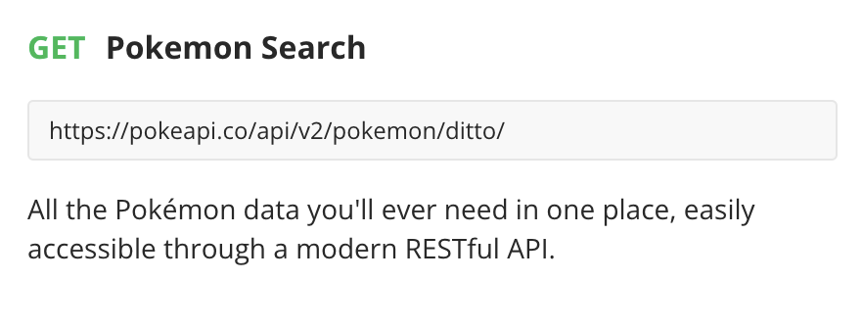
(My fiancé’s attempt at an Ash Ketchup impersonation, enjoy the cringe!)

Slide 5
Let’s get started!
In your terminal/CLI, navigate to the directory that you’d like your project to be stored in.
Then, write the following command:
dotnet new console --name WebAPIClient
This command is a sort of shortcut that creates a new console app the starter files for a basic "Hello World.” This command also names the project "WebAPIClient".

Slide 6
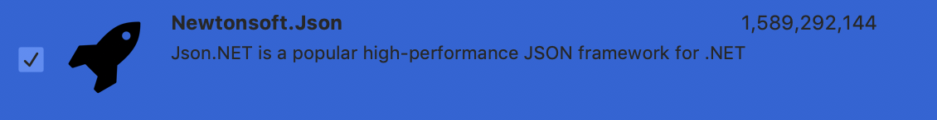
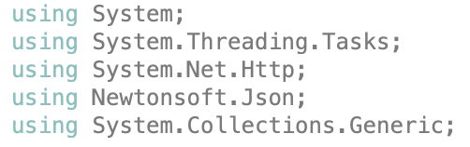
Setting things up…
Delete everything inside of the Main method.
Include the above libraries at the top of your Program.cs file! You’re going to need them.
You will need to install the Newtonsoft.Json NuGet package in order to use this library.

Slide 7
HTTPClient
Add a private, static, read-only HttpClient instance to your Program class.
HTTPClient allows us to send HTTP requests and receive HTTP responses from a resource identified by a URI.

Slide 8
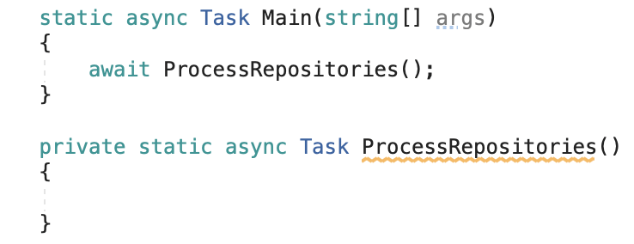
The ProcessRepositories Method
Make the Main method async, because it will call a new, private, static, async method that returns a Task called ProcessRepositories. Then, create that method, too.
A Task is an object that represents some work that should be done. The Task can tell you if the work is completed. The Task class represents a single operation that does not return a value and that usually executes asynchronously. For operations that return values, you use the Task<TResult> class.
The async keyword indicates to C# that the method is asynchronous, meaning that it runs independent of the main program flow and may use an arbitrary number of await expressions and will bind the result to a promise (Task).

Slide 9
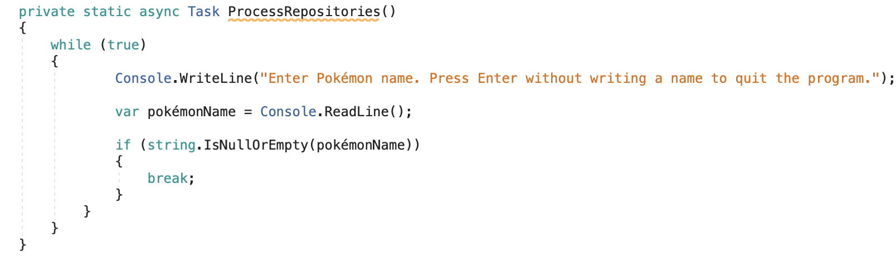
A Way Out
We want to be able to continue asking our user for Pokémon they want data on, until they’d like to exit the program.
In the ProcessRepositories method, create a while loop that will run infinitely. If the user hits the Enter key without writing anything, the loop will break.

Slide 10
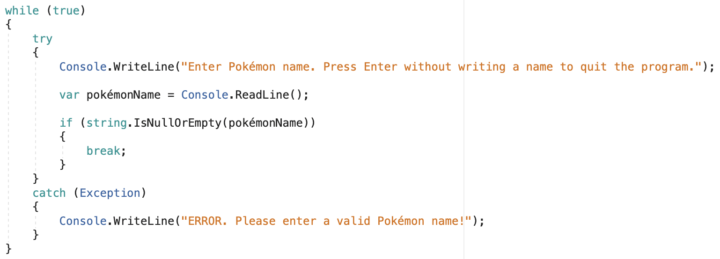
Catching Exceptions
Add a try-catch statement that looks for an Exception. If the API call throws an Exception due to invalid user input (for example, the name of a Pokémon that doesn’t exist), rather than giving the user a long and complicated message, you’ll get a more simplified statement.

Slide 11
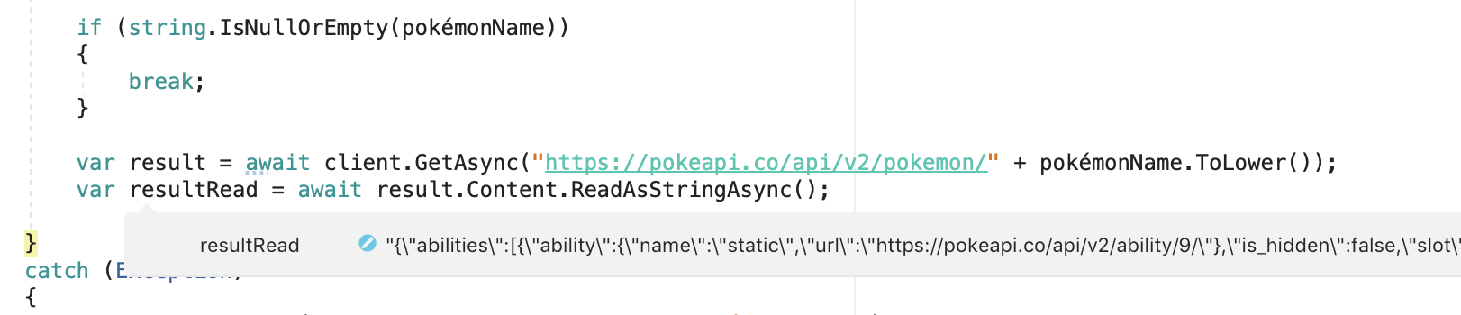
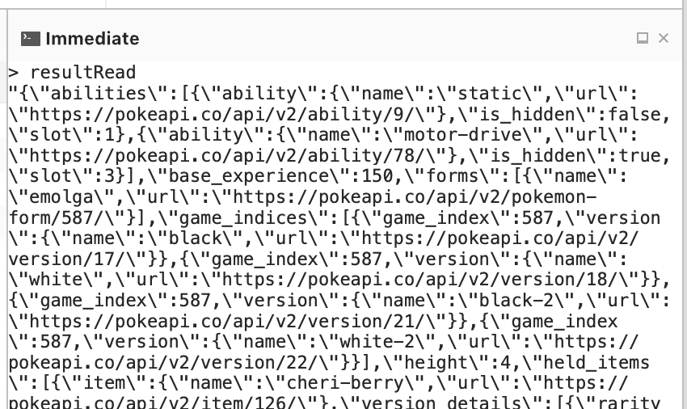
The API Call
Use your HttpClient’s GetAsync method to make your API call with user input! The result contains some children (StatusCode, ReasonPhrase, etc.) Take that result and use the Content child’s ReadAsStringAsync method.
ReadAsStringAsync serializes the HTTP content to a string as an asynchronous operation.
Serialization is the process of converting an object into a stream of bytes to store the object or transmit it to memory, a database, or a file. Its main purpose is to save the state of an object in order to be able to recreate it when needed. The reverse process is called deserialization.
If you set up a breakpoint after this call and then run a Debug build, you can see resultRead’s value! You can also look at the string in the Immediate window during this. Same goes for the initial result object.
I suggest you copy the value of the resultRead string and put it in an online JSON parser. This allows you to be able to read your results much more clearly. http://json.parser.online.fr/ is a great option!

Slide 12
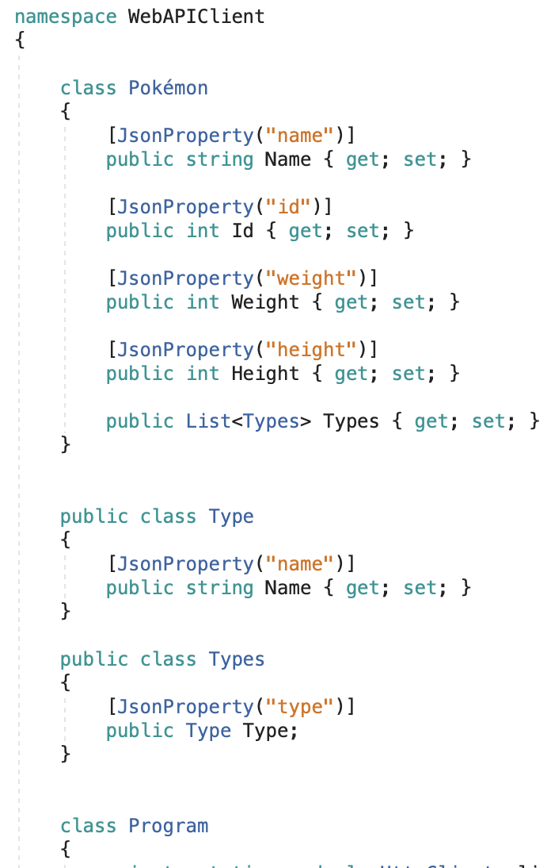
Setting Up Our Classes
We’re now going to set up some classes to put our data into!
Because each Pokémon in our results have an array of types that each have a name, we’re going to set up our classes to reflect that.
The JsonProperty attribute is placed on fields and properties to control how they should be serialized as a property in a JSON object!

Slide 13
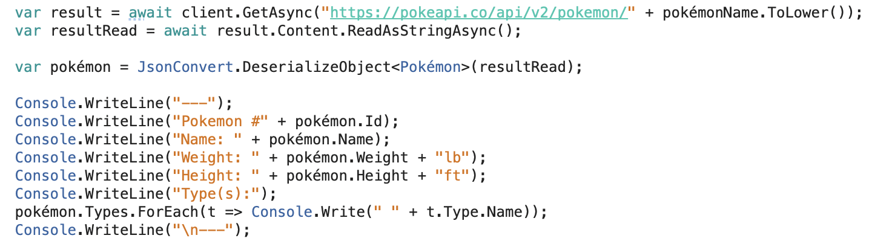
Serializing and Displaying Our Results
Now, we create our Pokémon! JsonConvert.DeserializeObject<Class>(string) deserializes with the help of the attributes we added to our classes. The new variable created in this line becomes an instance of the Pokémon class we created.
From there, we give the user our data and they’ll be prompted again. Well done!

Slide 14
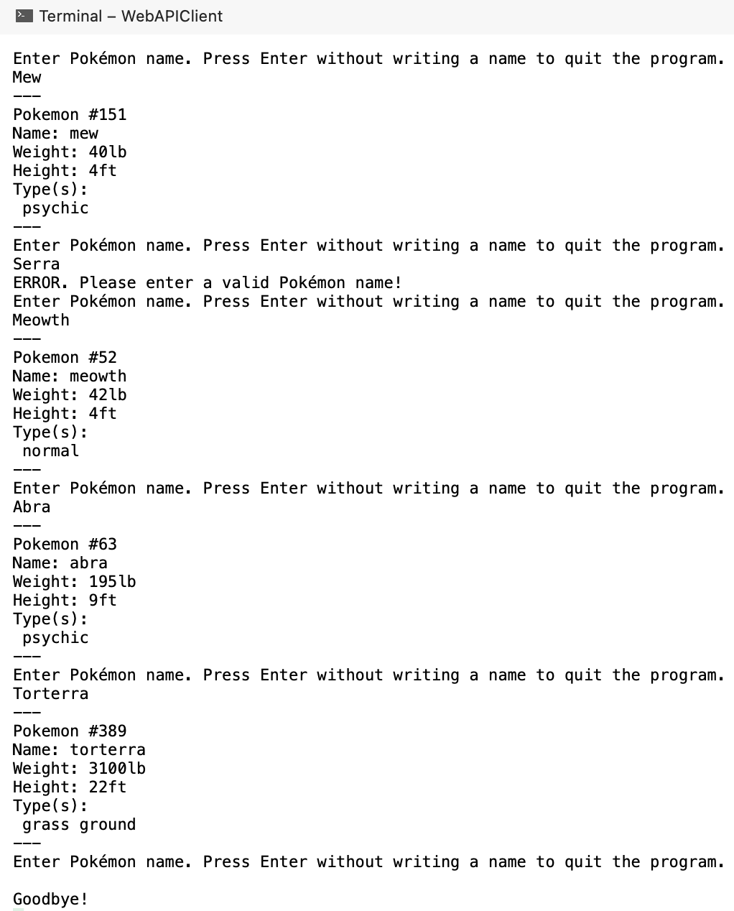

Slide 15
Activity #5
Call another API! Present to the user at least 3 pieces of data from an API endpoint. They must be put into an instance of a class or classes and then from there printed onto the console, as demonstrated. Send me the link to the repository on GitHub.
Here is a cool list of public APIs you can call to get started! https://documenter.getpostman.com/view/8854915/Szf7znEe

